Slide 1
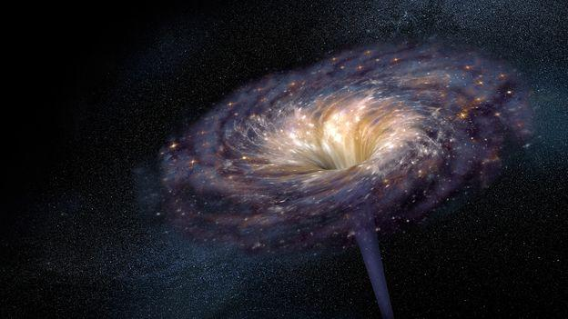
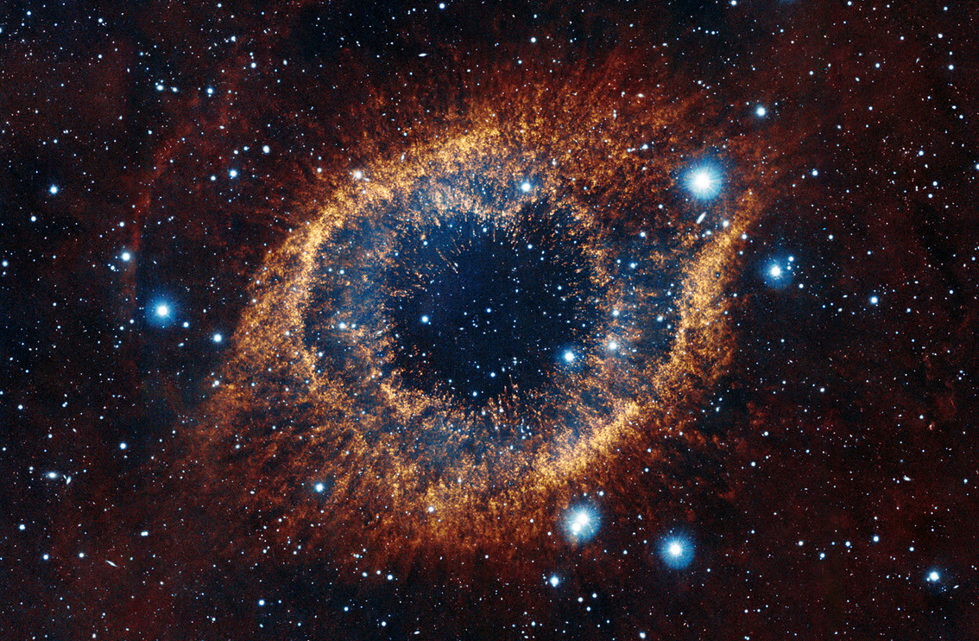
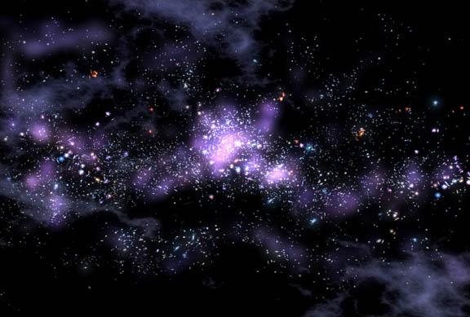
INTRODUCTION TO
The Astronomy Module
Lodha Genius Program 2023
Ashoka University
Astrophysics for Fun
Sushan Konar & Sourav Mitra
Science Project Faculties
Anantharaman S V & Umang Kumar
Teaching Fellows

Slide 2
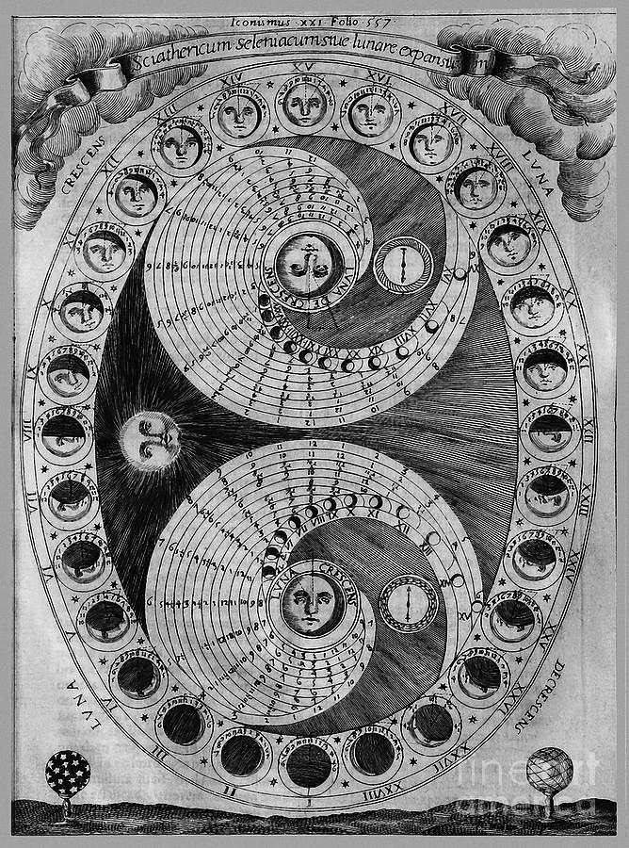
WHY STUDY ASTRONOMY & ASTROPHYSICS ?
OLDEST SCIENCE
Navigation
Agriculture
Religious festivals
EMERGENCE OF MODERN ASTRONOMY
WHEN DID ASTRONOMY BECOME ASTROPHYSICS?

Slide 3
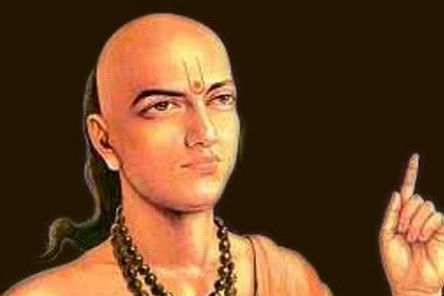
ARYABHATA
आर्यभट (476-550 CE)
VARAHAMIHIRA
BRAHMAGUPTA
BHASKARA
DID YOU KNOW?
Relating Mathematics & Astronomy
Arithmetic, algebra, plane trigonometry, spherical trigonometry, sum of power series, quadratic equations
Aryabhata was the first person who correctly insisted that the earth rotates about its axis daily, and that the apparent movement of the stars is a relative motion caused by the rotation of the earth

Slide 4
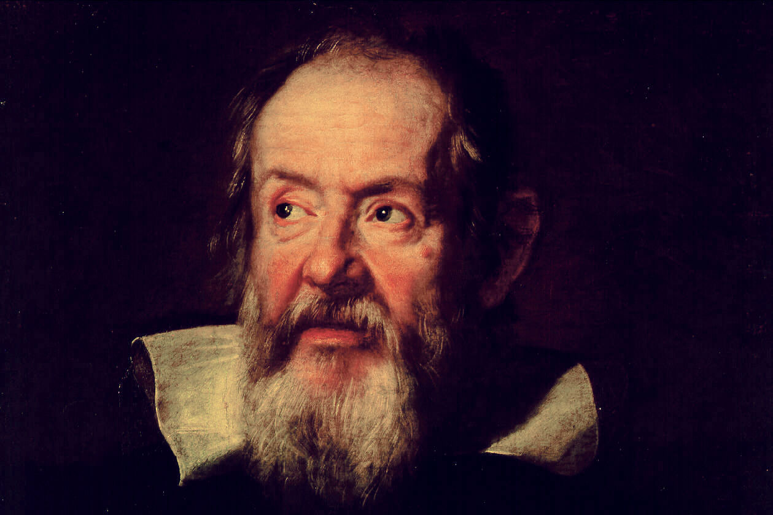
GALILEO GALILEI
FROM GALILEO’S DIARY (1610)
before that people believed things are imperfect only in Earth, the sky and outer space (heaven) are perfect! All the stars, Sun moves around us!

Slide 5
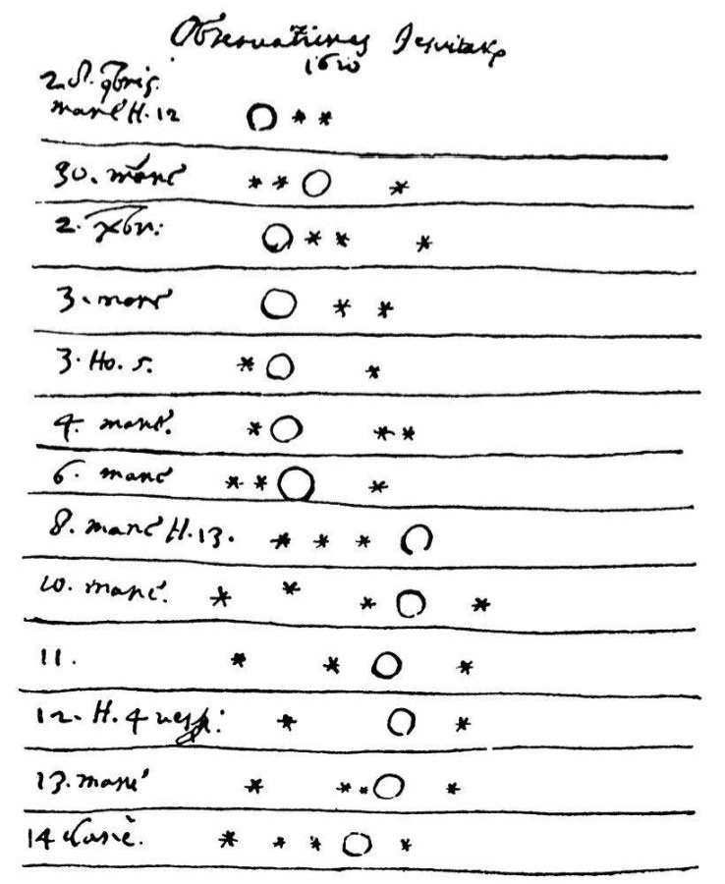
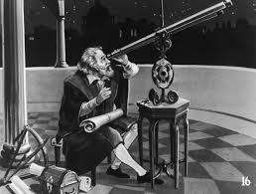
GALILEO GALILEI
FROM GALILEO’S DIARY (1610)
Galileo took his telescope and pointed at Jupiter (and 4 moons of it) - first time a telescope used by a scientist not by a sailor.

Slide 6
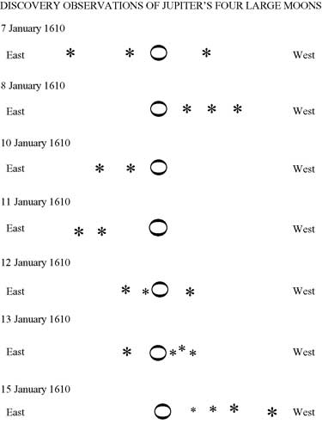
GALILEO GALILEI
FROM GALILEO’S DIARY (1610)
First time something is discovered in the Universe that moves around other thing than Earth --- beginning of modern Astronomy!

Slide 7
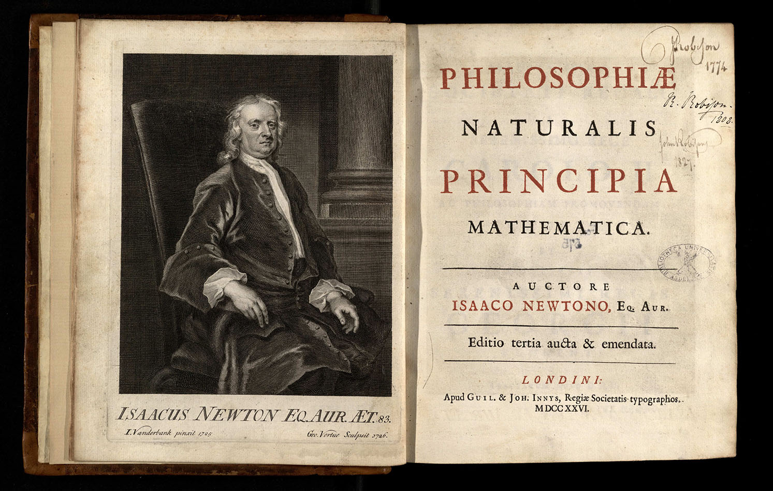
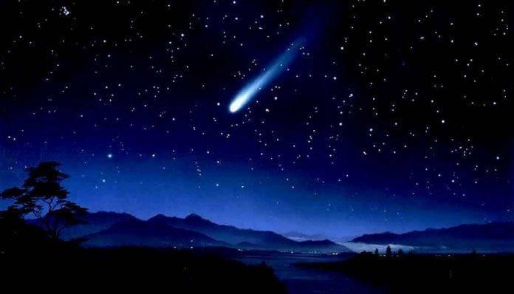
Basic Laws of Physics come from some basic Astronomical Questions!
Mathematical Principles of Natural Philosophy
ISAAC NEWTON
EDMOND HALLEY
(1687)
Why does the comet keep coming back in
every 75 years?

Slide 8
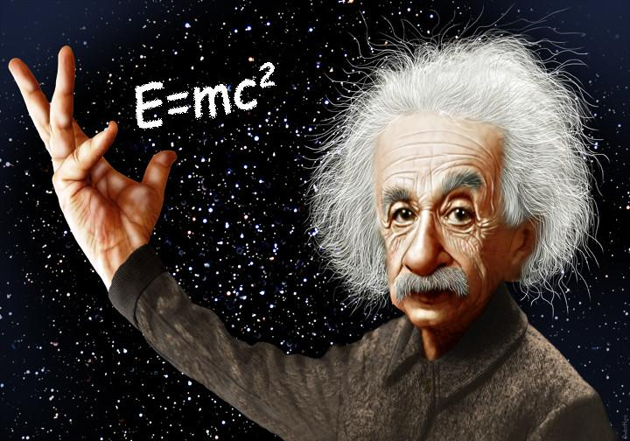
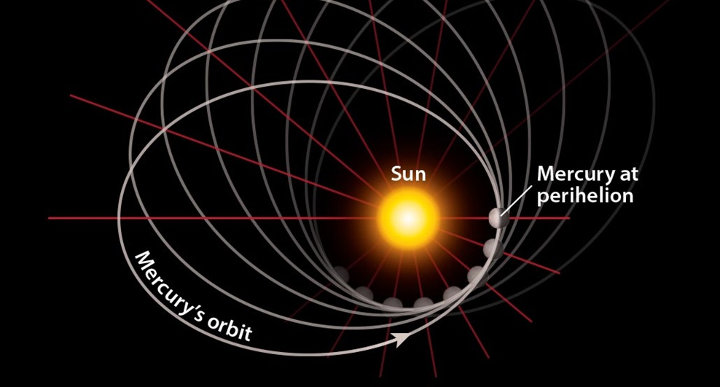
Basic Laws of Physics come from some basic Astronomical Questions!
General Theory of Relativity
ALBERT EINSTEIN
(1915)
Why Mercury's orbit
around Sun has an anomaly?
Light bending around star

Slide 9
ASTRONOMY IN OUR DAILY LIVES
DID
YOU KNOW?
Wireless Local Area Network (WLAN)
A method to sharpen images from a radio telescope and strengthen computer networks (John O’Sullivan, 1977)
Charge-Coupled Device (CCD)
Sensors for digital imaging in high resolution camera — first used in Astronomy in 1976 — Nobel prize in Physics 2009
Medical Imaging
Magnetic Resonance Imaging (MRI) scans, Computerized Tomography (CAT) scans, Positron Emission Tomography (PET) scans
Global Positioning System (GPS)
Rely on astronomical objects, such as quasars and distant galaxies, to determine accurate positions.
First Digital camera was build so that we can mount it on a telescope in space and get better pictures!

Slide 10
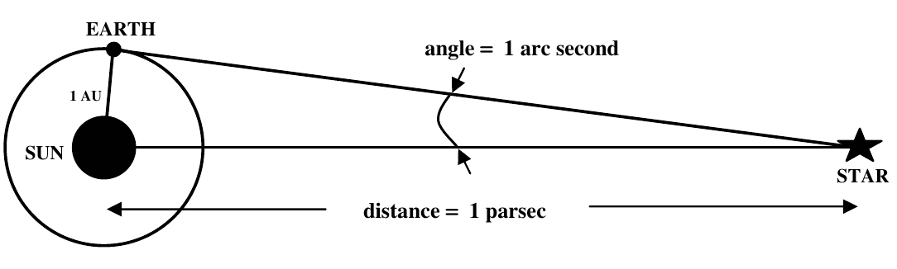
ASTRONOMICAL SCALES
Astronomical Distances
Units of distance measurement
1 Astronomical Unit (AU) — mean distance between the Sun and earth
1 AU = 1.5×10¹¹ m
1 Light Year (ly) — distance travelled by light in one year
1 ly = 9.46×10¹⁵ m = 6.3×10⁴ AU
1 Parsec (pc) — distance at which the radius of Earth’s orbit subtends an angle of 1′′
1 pc = 3.26 ly = 2×10⁵ AU = 3×10¹⁶ m
Note: 1∘ = 60′ and 1′ = 60′′, thus 1′′ = 1/3600 degree

Slide 11
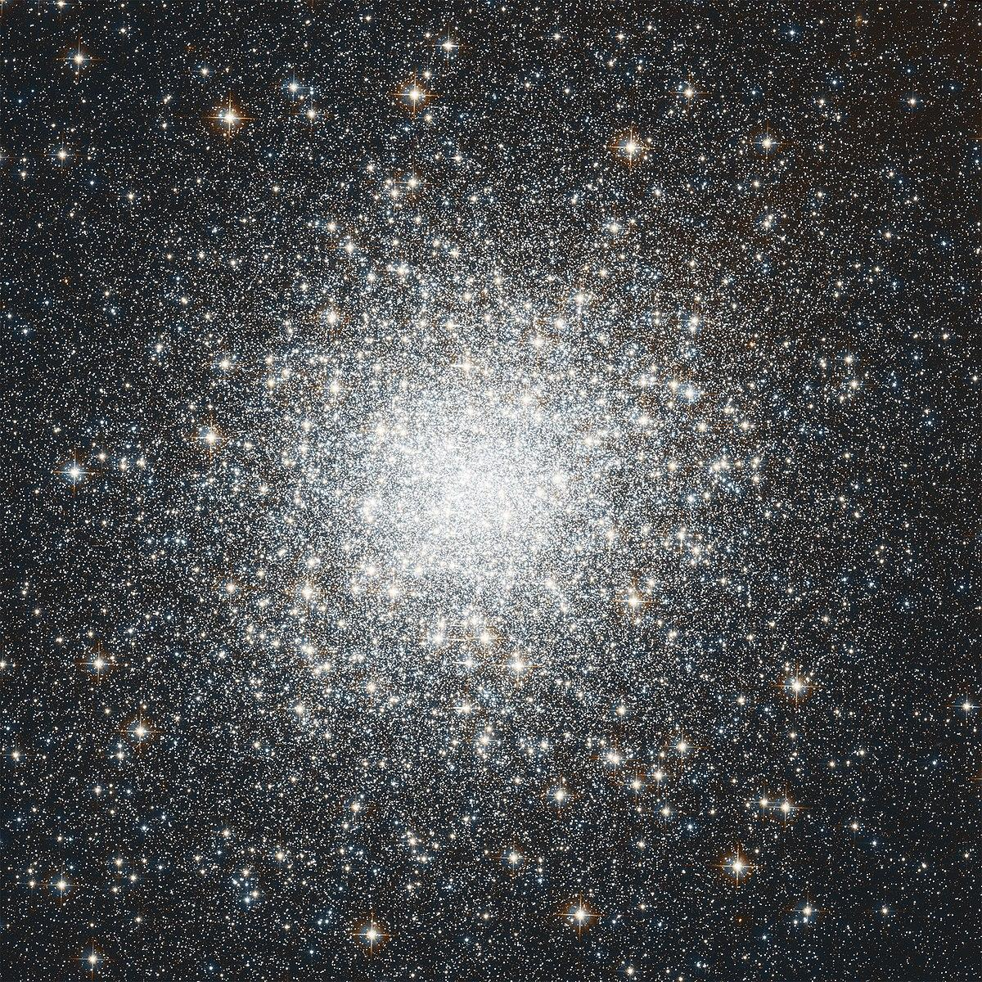
ASTRONOMICAL SCALES
Dimensions of Astronomical Objects
Unit of size measurement
1 Solar Radius (R⊙) — 7×10⁸ m
Masses of Astronomical Objects
Unit of mass measurement
1 Solar Mass (M⊙) — 2×10³⁰ kg
Mass of our galaxy ~ 10¹¹ M⊙
Mass of globular cluster ~ 10³ - 10⁶ M⊙
Chandrasekhar Mass Limit 1.4 M⊙
Mass of Earth ~ 10⁻⁶ M⊙ Your mass ~ 2-5×10⁻²⁹ M⊙

Slide 12
ASTRONOMICAL SCALES
Time Scales
Human race appeared about 1-7 million (10⁶) years ago
Age of Earth 4.5 billion (10⁹) years
Age of Sun is about 5 billion years
Age of our galaxy ~ 10 billion years
Age of Universe ~ 14 billion years.
On the other hand, if the pressure inside a star is insufficient to support it against gravity, then it may collapse in a time which may be measured in seconds!

Slide 13
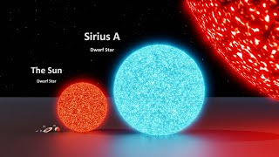
TIME FOR A SHORT VIDEO.
Quick Mind-boggling Math
(1 million = 1,000,000; 1 billion = 1,000,000,000)
Earth is about 3.5 million times larger than a human.
Solar System is about 36 billion times larger than Earth
Milky Way is about 100 million times larger than Solar system
Size of Universe is about 1 million times that of Milky Way
Universe is about 10,000,000,000,000,000,000,000,000,000,000
times bigger than human

Slide 14
ROUGH PLAN FOR THE PROJECT
Activity #1 — Astronomical Measurements
Concept of astronomical distance, masses, angular sizes – average density of Sun from its angular size, estimation of Moon’s volume, celestial cycles
Activity #2 — Astronomical Measurements : Radius of the Earth
Zero Shadow Day (ZSD) — measuring the radius of the Earth
Activity #3 — Astronomical Measurements : Solar System
Venus Transit — How to measure distances between solar system objects
Activity #4 — Gravitation : May the force be with you …
How every little surface asymmetry of a self-gravitating, spherical object can give rise to gravitational waves — are we capable of detecting those?

Slide 15
ROUGH PLAN FOR THE PROJECT
The Project Stories: Science from Fiction
Marooned off Vesta,
Isaac Asimov, Amazing Stories, 1939, Ziff-Davies Publishing Co.
Neutron Star,
Larry Niven, Neutron Star, 1966, Ballantine
Summertime on Icarus,
Arthur C. Clarke, The Nine Billion Names of God, 1967, Signet.
Walk in the Sun,
Geoffrey Landis, Impact Parameter, 2001, Golden Gryphon Press.
Cool Neighbour,
Jack McDevitt & Miclael Shara, Cryptic: The Best Short Fiction of Jack McDevitt, 2009, Subterranean Press

Slide 16
A QUICK CHECK
First calculate value of G (6.67×10⁻¹¹ m³kg⁻¹s⁻²) in terms of AU, M⊙, yr
Planet | Avg. distance from Sun (km) | Avg. Orbital Velocity (km/s) | Avg. distance from Sun in AU | Time Period in yr.
Mercury | 5.8×10⁷ | 47.87
Venus | 1.08×10⁸ | 35.02
Earth | 1.5×10⁸ | 29.78
Mars | 2.28×10⁸ | 24.08
Jupiter | 7.79×10⁸ | 13.07
Saturn | 1.43×10⁹ | 9.69
Uranus | 2.87×10⁹ | 6.81
Neptune | 4.49×10⁹ | 5.43
*Pluto (dwarf planet) | 5.91×10⁹ | 4.74

Slide 17
A QUICK CHECK
First calculate value of G (6.67×10⁻¹¹ m³kg⁻¹s⁻²) in terms of AU, M⊙, yr
Planet | Avg. distance from Sun (km) | Avg. Orbital Velocity (km/s) | Avg. distance from Sun in AU | Time Period in yr.
Mercury | 5.8×10⁷ | 47.87 | 0.387 | 0.24
Venus | 1.08×10⁸ | 35.02 | 0.72 | 0.61
Earth | 1.5×10⁸ | 29.78 | 1 | 1
Mars | 2.28×10⁸ | 24.08 | 1.52 | 1.89
Jupiter | 7.79×10⁸ | 13.07 | 5.19 | 11.87
Saturn | 1.43×10⁹ | 9.69 | 9.53 | 29.40
Uranus | 2.87×10⁹ | 6.81 | 19.13 | 83.97
Neptune | 4.49×10⁹ | 5.43 | 29.93 | 164.75
*Pluto (dwarf planet) | 5.91×10⁹ | 4.74 | 39.40 | 248.42

Slide 18
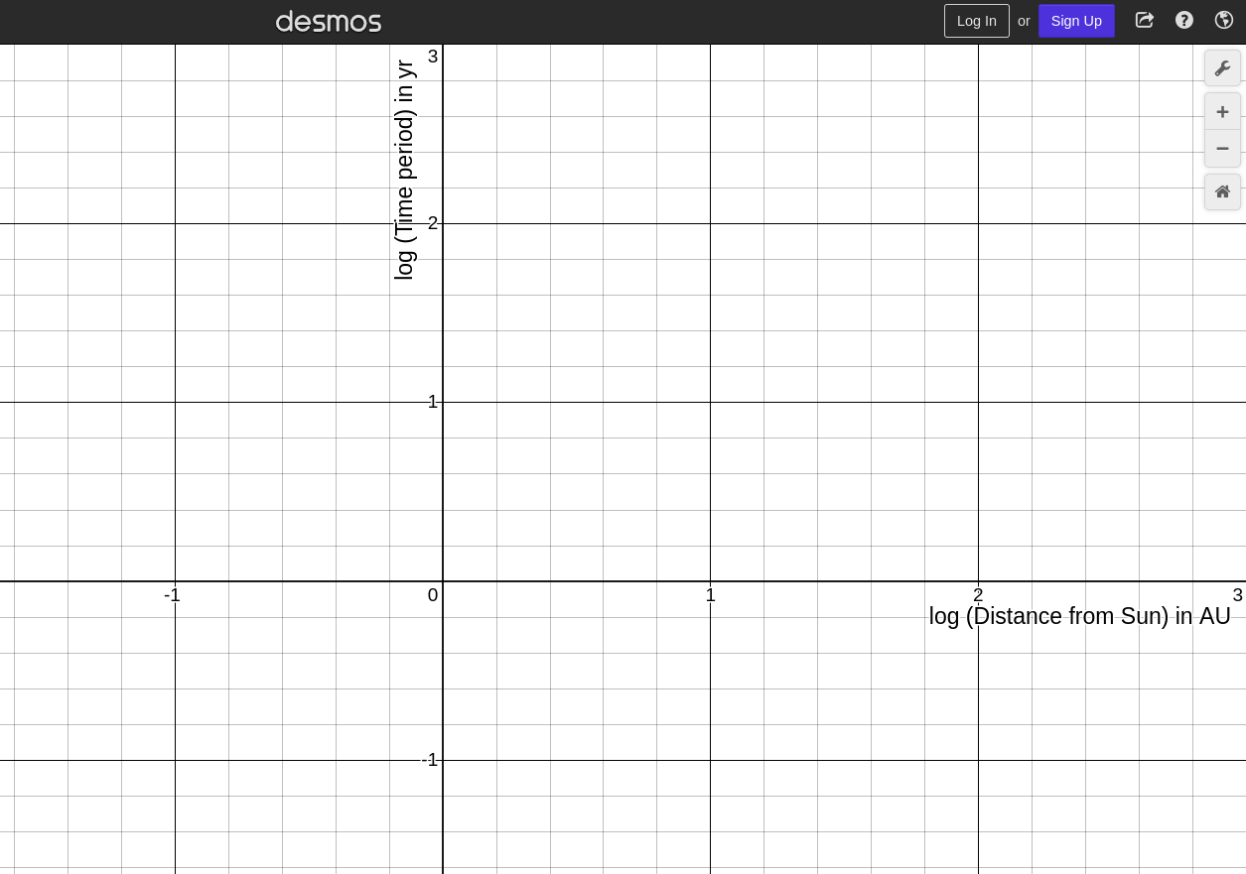
A QUICK CHECK
First calculate value of G (6.67×10⁻¹¹ m³kg⁻¹s⁻²) in terms of AU, M⊙, yr
Plot log₁₀(Time period) vs. log₁₀(Distance) — Identify the equation & calculate the slope
Derive Kepler’s 3rd law of planetary motion from Newton’s law of Gravitation
What happened to the proportionality constant (4π²/GM)?
What are the advantages of plotting in log-scale?
Pluto

Slide 19
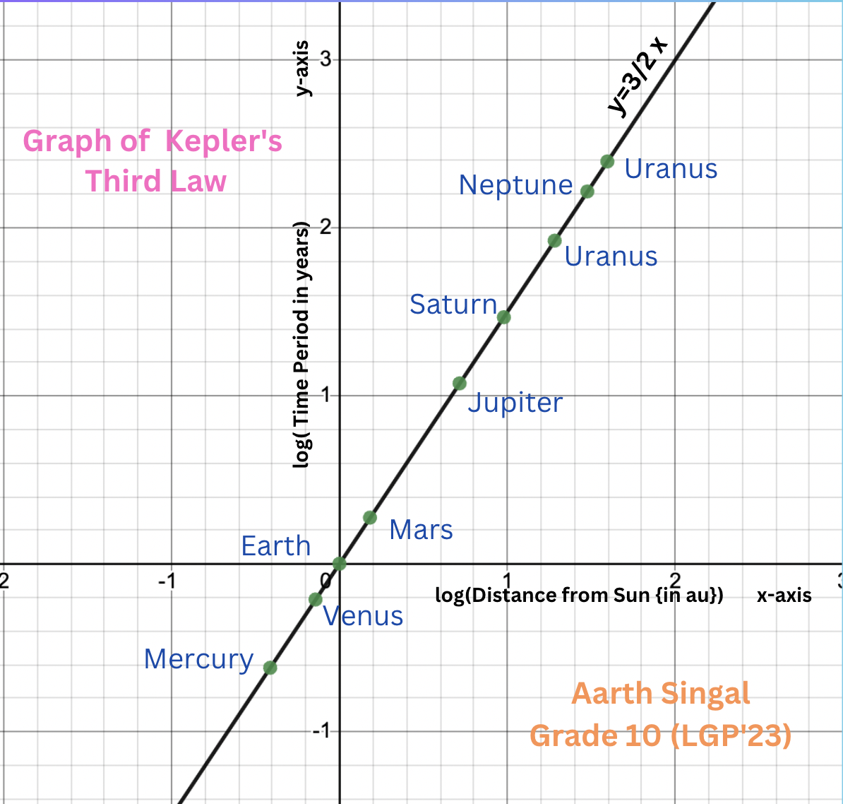
A QUICK CHECK
First calculate value of G (6.67×10⁻¹¹ m³kg⁻¹s⁻²) in terms of AU, M⊙, yr
Plot log₁₀(Time period) vs. log₁₀(Distance) — Identify the equation & calculate the slope
Derive Kepler’s 3rd law of planetary motion from Newton’s law of Gravitation
What happened to the proportionality constant (4π²/GM)?
What are the advantages of plotting in log-scale?
Pluto

Slide 20
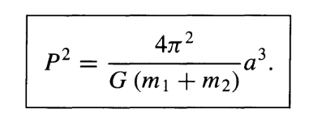
PROBLEMS
The orbital period of Moon is measured to be 27.3 days and the Sun is about 400 times farther away from us than the Moon. Assuming a circular orbit, estimate the mass of Earth using Kepler’s third law (before that, using Kepler’s law, estimate the mass of Sun).
The orbital period of Io, one of the four Galilean moons of Jupiter, is 1.77 days and the semimajor axis of its orbit is 4.22 ×10⁸ m. Assuming that the mass of Io is insignificant compared to that of Jupiter, find out the mass of Jupiter.
Kepler's Third Law (revisited):

Slide 21
PROBLEMS
The orbital period of Moon is measured to be 27.3 days and the Sun is about 400 times farther away from us than the Moon. Assuming a circular orbit, estimate the mass of Earth using Kepler’s third law (before that, using Kepler’s law, estimate the mass of Sun).
The orbital period of Io, one of the four Galilean moons of Jupiter, is 1.77 days and the semimajor axis of its orbit is 4.22 ×10⁸ m. Assuming that the mass of Io is insignificant compared to that of Jupiter, find out the mass of Jupiter.
The Sun, in fact, our whole solar system orbits (assuming circular) around the center of the Milky Way galaxy at an average speed of 230 km/s. If Sun is about 8 kpc away from the center of Milky Way, find out how much time it will take to make one complete orbit around it. Also calculate how many times it has already done such complete rotation since birth. Age of Sun is about 5 billion years.

Slide 22
PROBLEMS
The orbital period of Moon is measured to be 27.3 days and the Sun is about 400 times farther away from us than the Moon. Assuming a circular orbit, estimate the mass of Earth using Kepler’s third law (before that, using Kepler’s law, estimate the mass of Sun).
ANS:
d = 382500 km = 382500×10³ m
T = 27.3 days = 27.3×86400 s
G = 6.67×10⁻¹¹ m³kg⁻¹s⁻²
From Kepler’s third law: M_{E} = (4π²/G) d³/T² = 5.95×10²⁴ kg

Slide 23
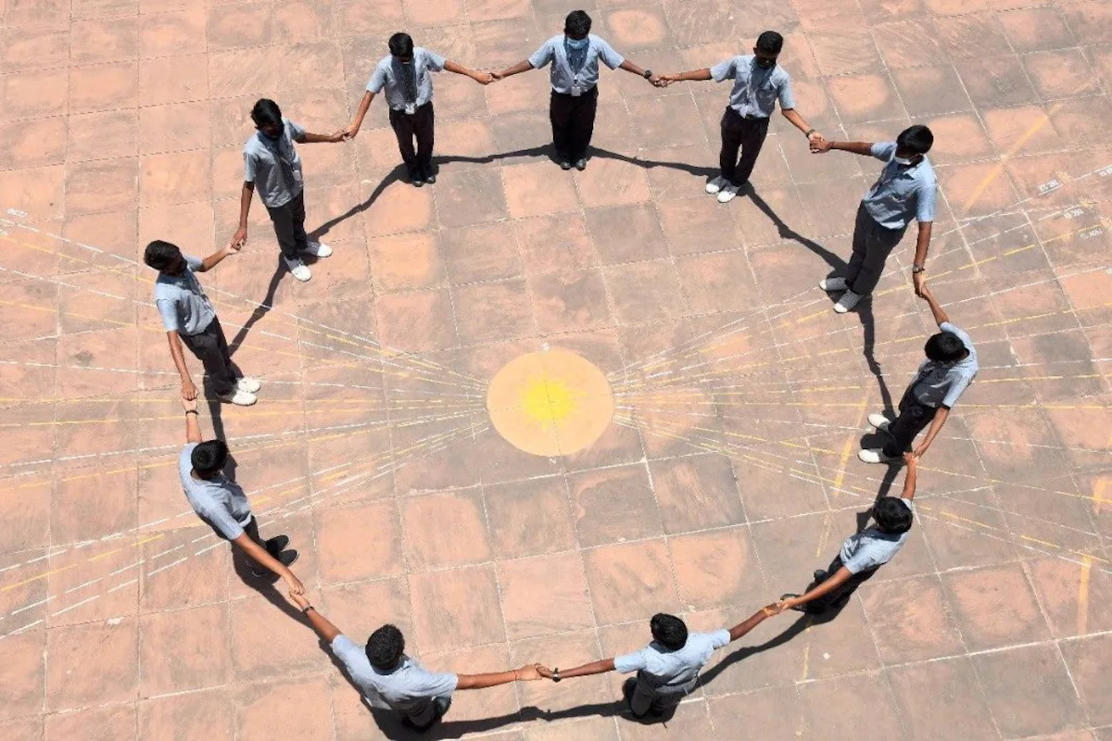
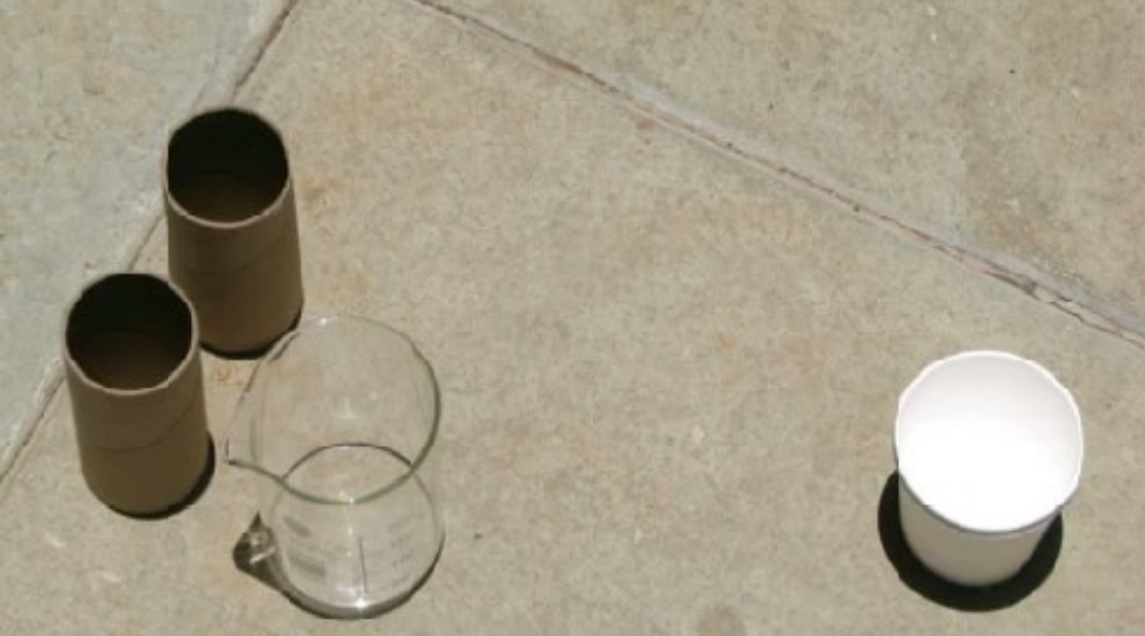
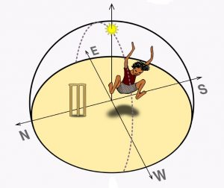
ZERO SHADOW DAY

Slide 24
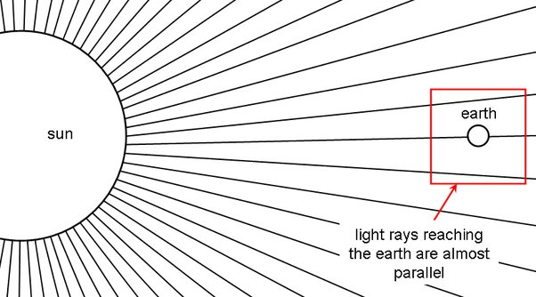
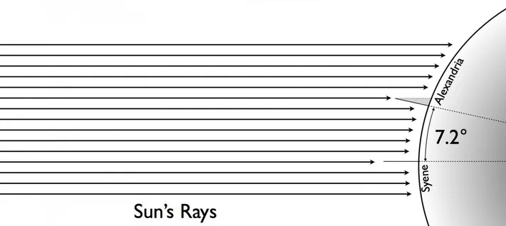
Can Sun be directly overhead (at noon) at every locations?

Slide 25
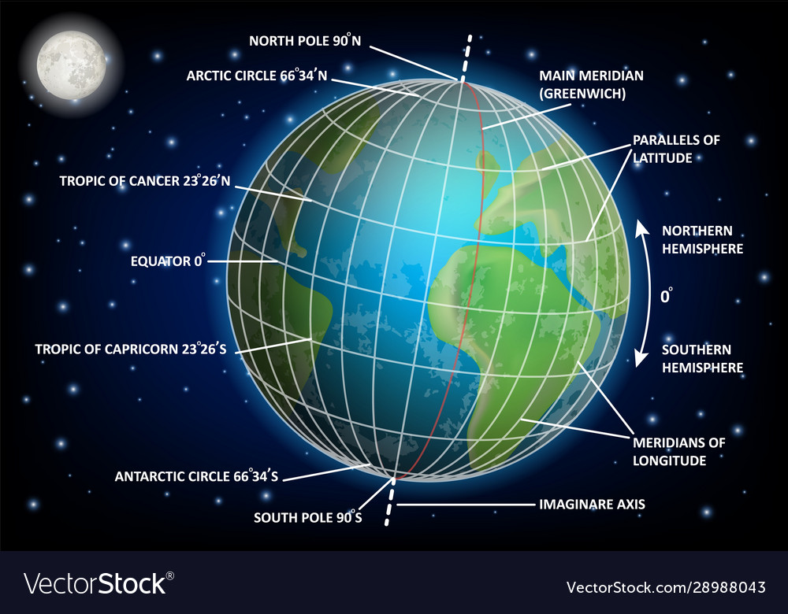
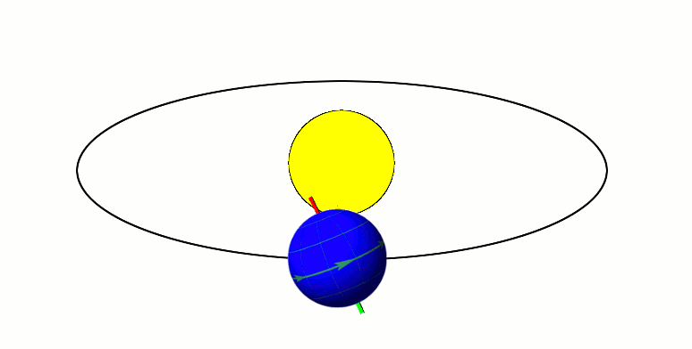
Are those locations Fixed?
Earth's spin-axis is tilted at 23.5 degrees with respect to the plane of the Ecliptic (plane of the Earth's orbit)

Slide 26
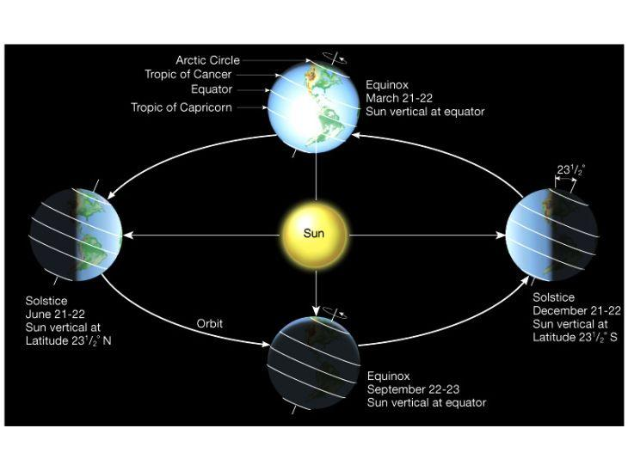
Zero Shadow Day - When & Where?

Slide 27
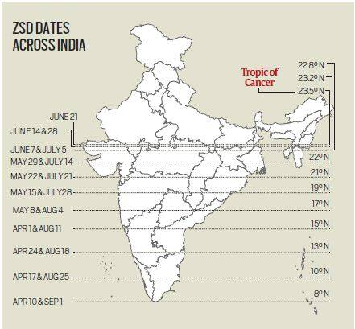
Zero Shadow Day - When & Where?
Why do the dates appear in pairs?

Slide 28
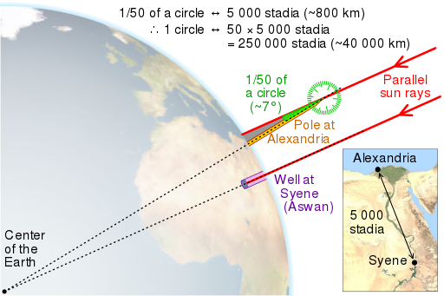
How did Eratosthenes (276-194 BC) measure Earth’s size?
Sun was directly overhead at Syene, Egypt (known today as Aswan)
On the same date in Alexandria, a rod perpendicular to the ground cast a shadow that was 7°12' from perpendicular
He divided 360° by 7°12' and determined that 7°12' was 1/50th of a circle - multiplied the distance from Syene to Alexandria by 50 to get the earth's circumference.

Slide 29
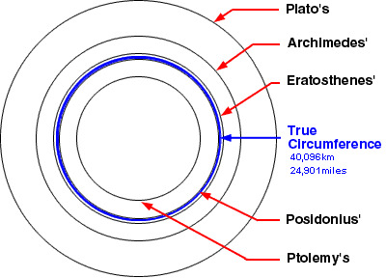
How did Eratosthenes (276-194 BC) measure Earth’s size?
Eratosthenes' errors:
Syene is NOT on the Tropic of Cancer — it is actually 37 kilometers (23 miles) north of the Tropic of Cancer.
Alexandria is NOT exactly due north of Syene and and the distance between them is NOT 800 kilometers.
No modern gadgets, no fancy measurements — just simple geometry of shadows and he had a reasonably accurate estimate of Earth's radius more than 2250 years ago!

Slide 30
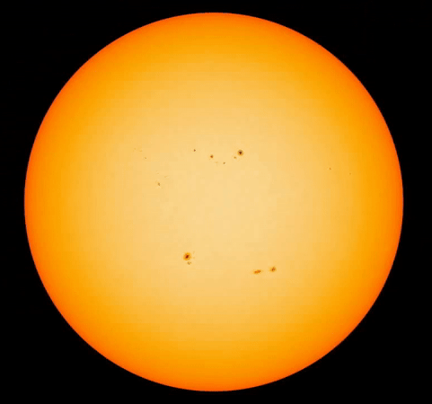
VENUS TRANSIT

Slide 31
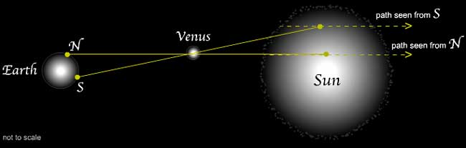
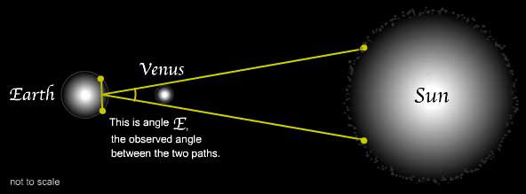
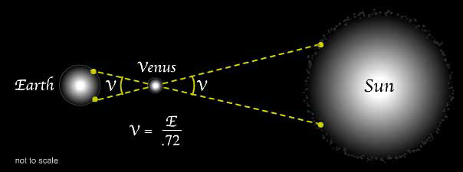
How the Transit of Venus Tells Us Our Distance from the Sun

Slide 32
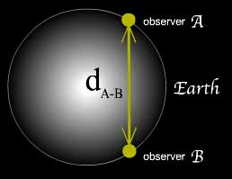
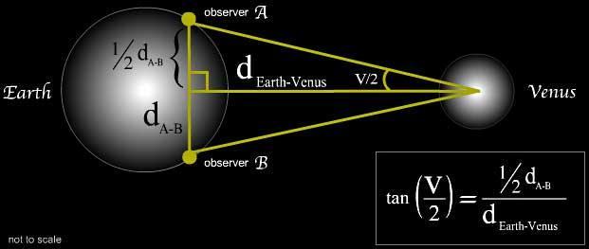
How the Transit of Venus Tells Us Our Distance from the Sun
During a particular Venus transit event, two observers one at Honolulu and other at Anchorage find the gaps between two transit paths as seen from their locations. That difference corresponds to the angle E = 0.0038 degree. Given the radius of Earth to be 6400 km, find out 1AU in km.

Slide 33
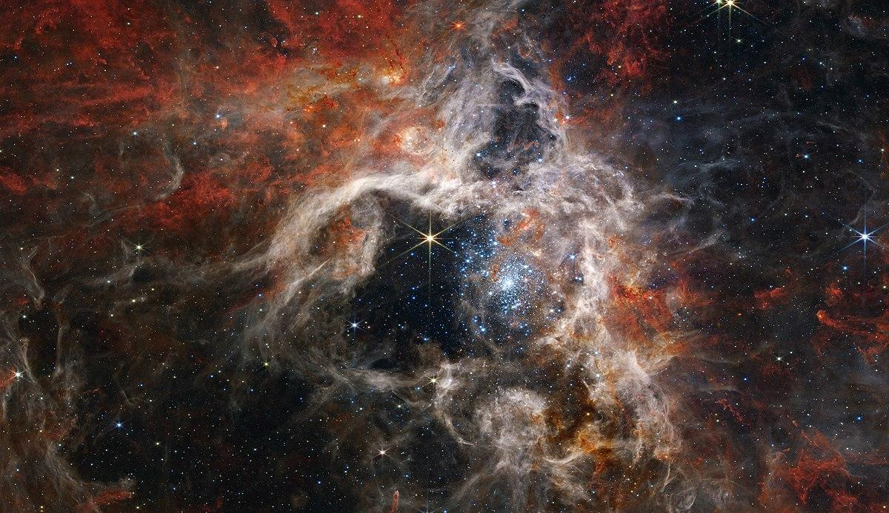
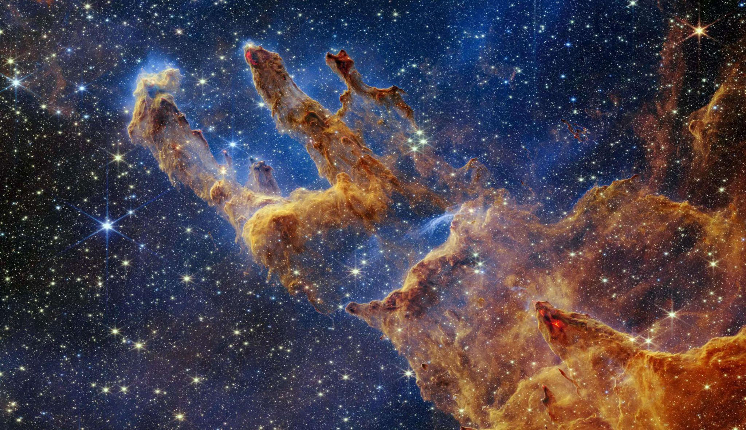
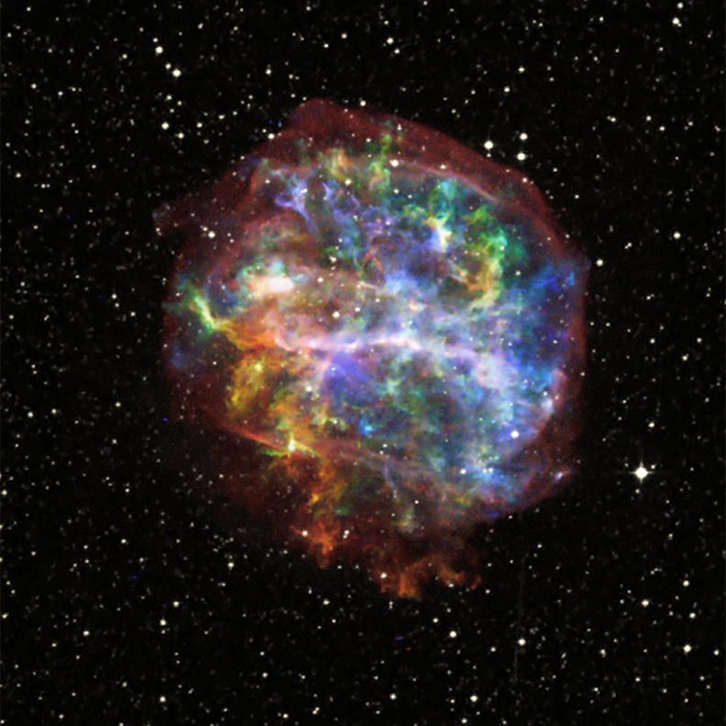
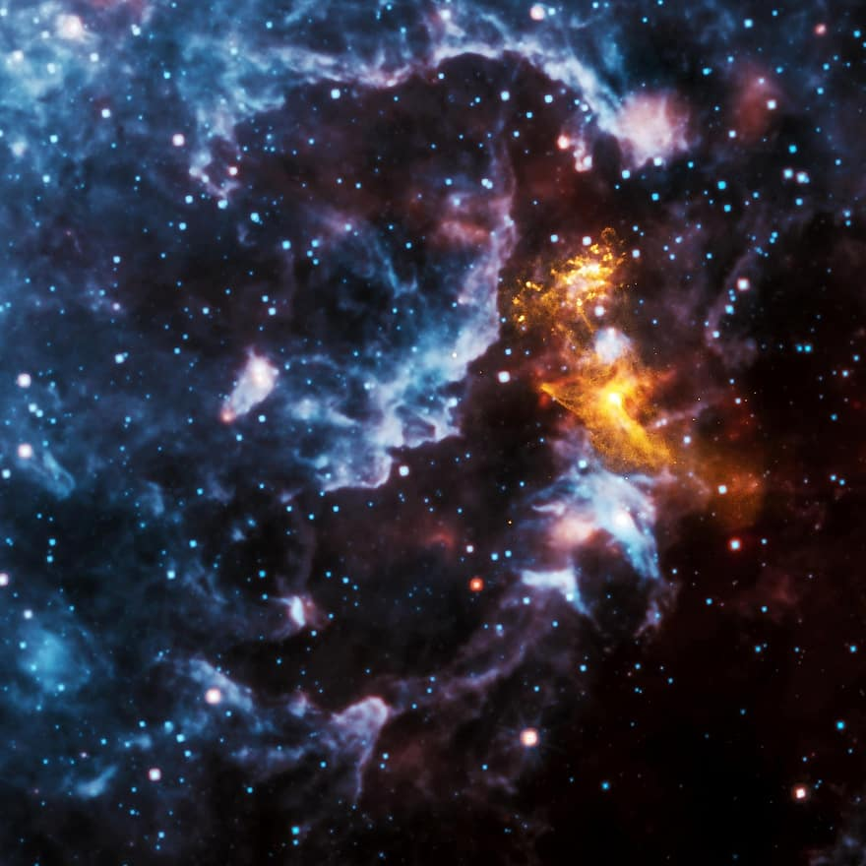
X-RAY VISION
Creating False-Color Images from Raw Data

Slide 34
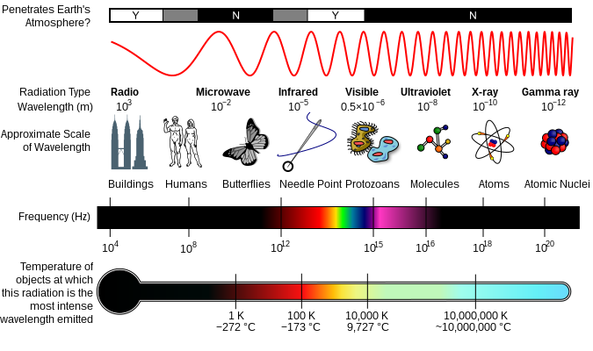
Electromagnetic Spectrum
Humans can only actually see a very small part of the electromagnetic spectrum

Slide 35
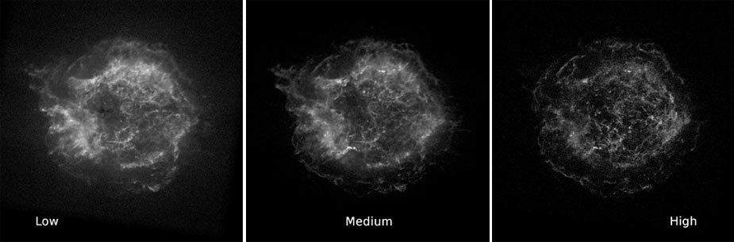
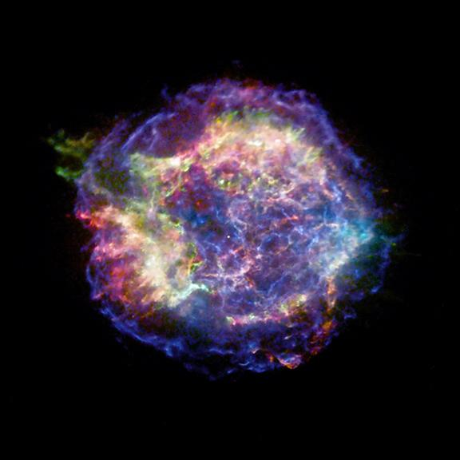
False-coloring the Images taken by the Chandra X-ray Observatory
Original low, medium, and high-energy band x-ray images
Supernova remnant Cassiopeia A (Cas A)

Slide 36
False-coloring the Images taken by the Chandra X-ray Observatory
Go to Google — search “chandra open fits” — Open X-ray only Fits files
Browse through the images and choose one you would like to work with for your science project (except #3-M87 and #20-Crab Nebula) - Download the raw FITS files
Open files in GIMP as “Open as layers” (should be ordered from the top down as "hard", "medium" and "soft") and Switch to RGB - clicking on Image->Mode->RGB for every layer
Change each layer Mode to “Screen” from “Normal”
Adjust Color levels by clicking Colors->levels for each layer to make them more visible
Apply Smoothing Algorithm to each layer — clicking Filters->G’MIC-Qt
Add Colors — clicking Colors->Colorize — adjust Hue, Saturation, Lightness
Add Red hue to soft image (low-energy band), Green to medium (mid-energy band) and Blue to hard (high-energy band) images
The Finishing Touches — tweaking the editor until you are happy!
Find publicly available data from other telescopes (for example, radio or infrared) and apply the same procedure

